Slide 1

Interest Rates and their predictive Power on the Stock market
by Aaron Gresser

Slide 2
Agenda
A brief Introduction
Research Questions
Dataset Overview
Approach and Methods
Outlook
Intro
Notes:
https://www.reddit.com/r/Forex/comments/c3wjo1/gold_dinosaur_sell_pattern/#lightbox

Slide 3
The Stock Market – An Introduction
The Basics of Price Building
Efficient Market Hypothesis (EMH)
The Role of Institutional Investors¹
Reserve Banks & Monetary Policy
Notes:
⁽¹https://accountinginsights.org/retail-investors-vs-institutional-investors-percentage-breakdown-explained/#:~:text=Retail%20investors%20are%20individuals%20buying%20stocks%2C%20bonds%2C%20or,of%20influence%20shape%20market%20trends%2C%20liquidity%2C%20and%20volatility.)

Slide 4
Research Questions
Do “Interest Rate Change-Announcements” create predictable Stock Market movements?
Can Sentiment Analysis contribute to a more accurate market prediction?
Does the implementation of more complex models improve the effectiveness of the prediction?

Slide 5

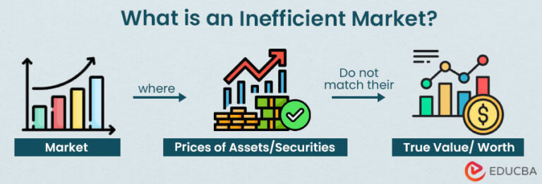
Market Inefficiencies
Behavioral Biases
Macroeconomic Shocks
Structural Barriers
Time Lags
Information Asymmetry
Notes:
Refernce: https://www.dbrownconsulting.net/terms/m/Market-Inefficiency#:~:text=Market%20inefficiency%20occurs%20when%20asset%20prices%20deviate%20from,flow%2C%20investor%20behavior%2C%20transaction%20costs%2C%20or%20regulatory%20barriers. Picture’s: 1. https://www.educba.com/inefficient-market/ 2. https://www.bing.com/images/search?view=detailV2&ccid=i7dUVppv&id=322F2DF41D3B8FBD39BBB26DC1CF818A495458F4&thid=OIP.i7dUVppvX4FTucQ74owHFAHaF-&mediaurl=https%3a%2f%2fth.bing.com%2fth%2fid%2fR.8bb754569a6f5f8153b9c43be28c0714%3frik%3d9FhUSYqBz8Ftsg%26riu%3dhttp%253a%252f%252fcdn.shopify.com%252fs%252ffiles%252f1%252f0286%252f2949%252f9986%252fcollections%252fWSB_-_Subreddit_Logo_1200x1200.png%253fv%253d1612311193%26ehk%3dKEIFjFJw%252fTEGLfrNChh1b7VEZe5YP6dZ9Iah%252fyVCjnQ%253d%26risl%3d%26pid%3dImgRaw%26r%3d0&exph=807&expw=1000&q=wallstreet+bets+transparent&simid=608033629268627619&FORM=IRPRST&ck=D6B5BAF23A0C97744BCA24283EBBD210&selectedIndex=1&itb=1

Slide 6
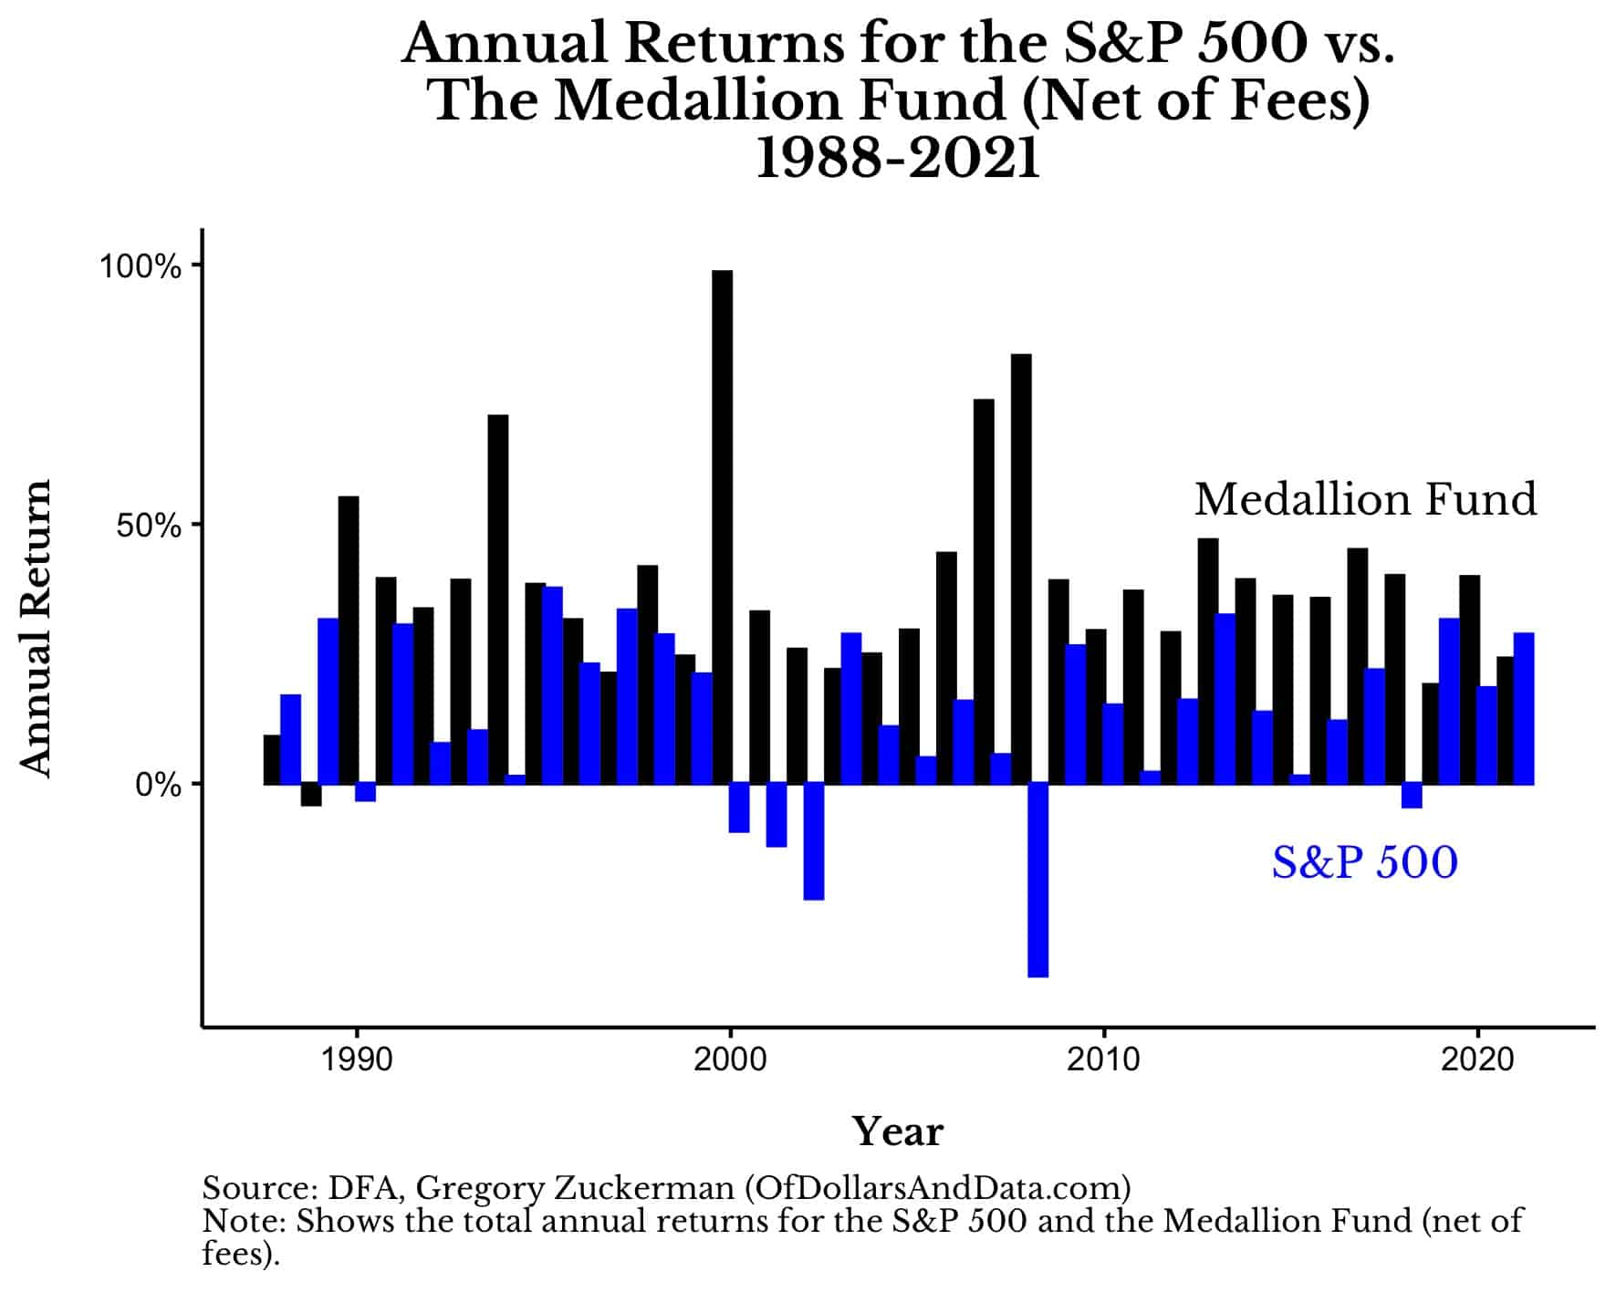
Applications of Data Science
Quantitative Finance
High Frequency Trading
Algorithmic Trading
Momentum Trading
Notes:
https://debeeqpetronille.pages.dev/ncijhd-renaissance-technologies-returns-krvcdwsmr-photos/

Slide 7
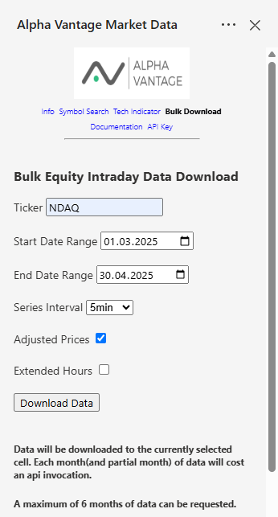
Dataset Overview
API-Sources
AlphaVantage
yFinance
Feder Reserve Board
Press Statements
Stock Data
European Central Bank
Notes:
https://www.alphavantage.co/documentation/

Slide 8
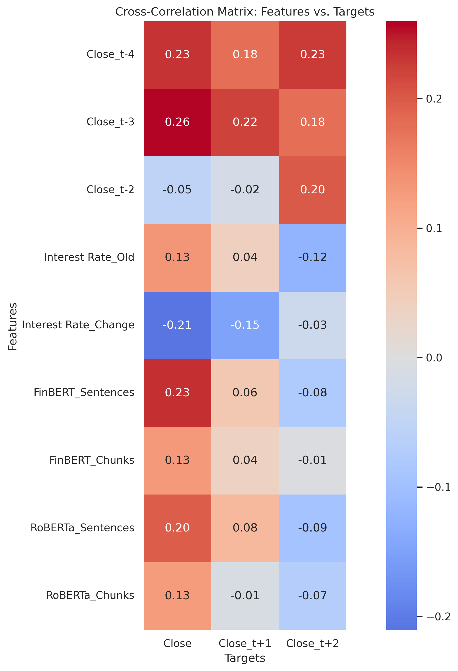
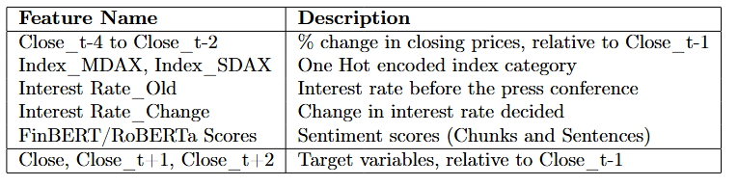
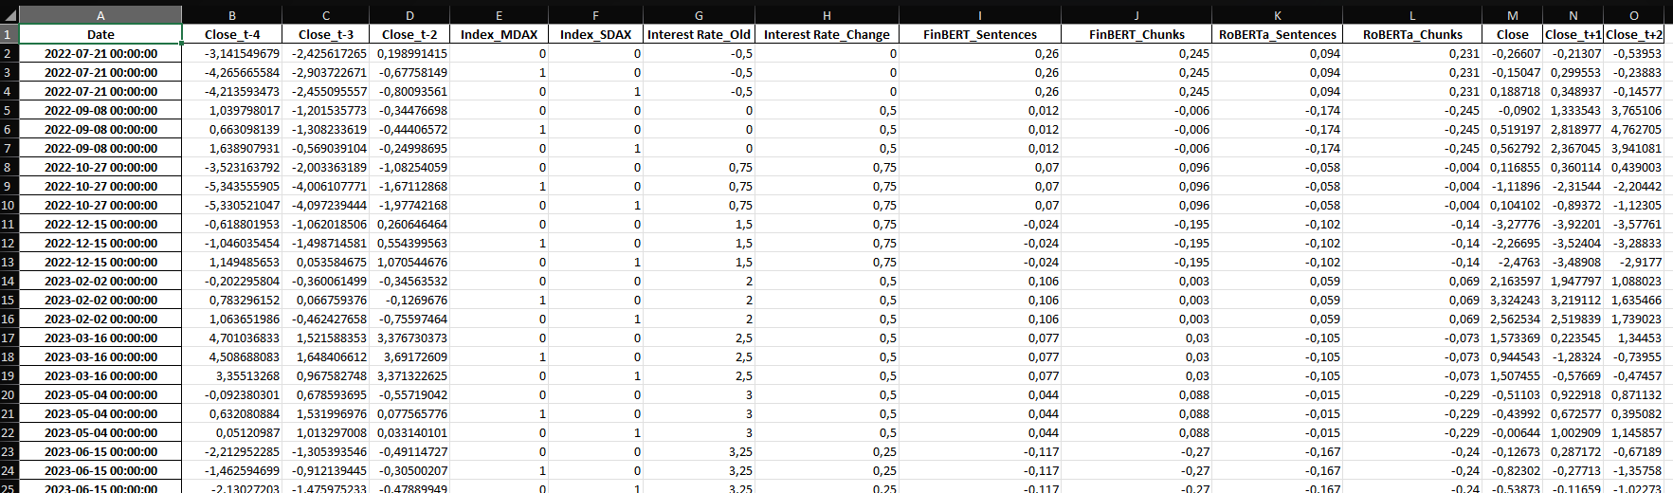
Dataset Overview

Slide 9
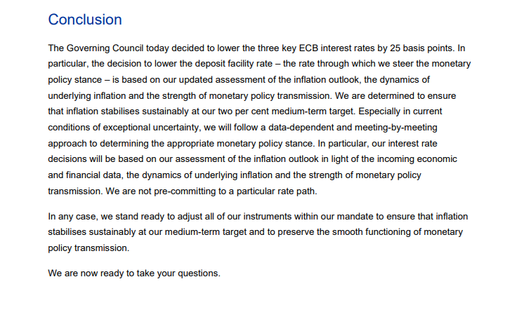
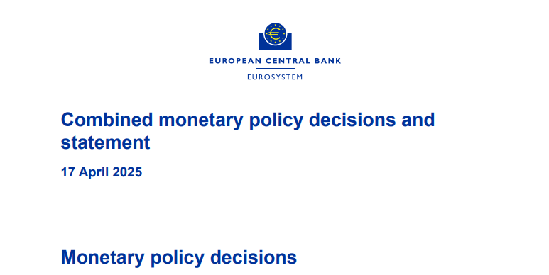
Notes:
https://data.ecb.europa.eu/

Slide 10
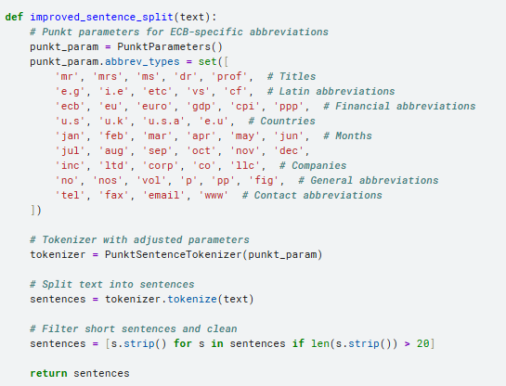
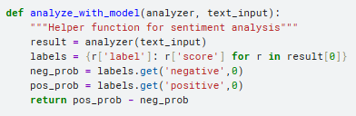
Sentiment Analysis - Pipeline

Slide 11
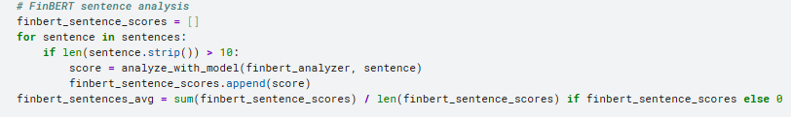
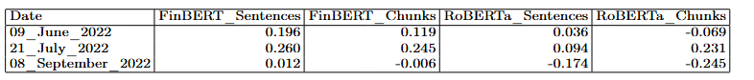
Sentiment Analysis - Results

Slide 12
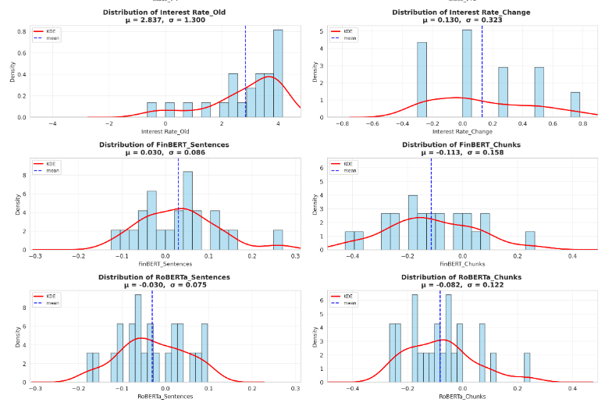
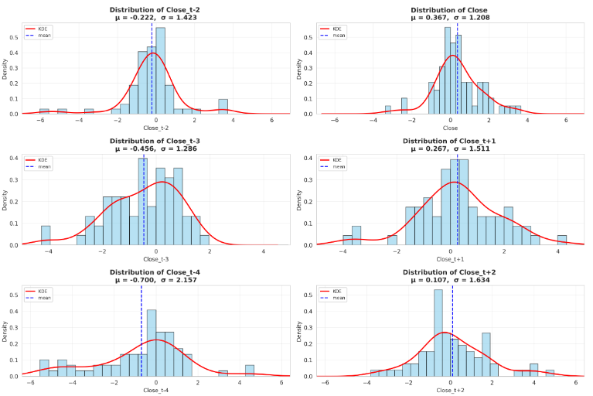

Slide 14
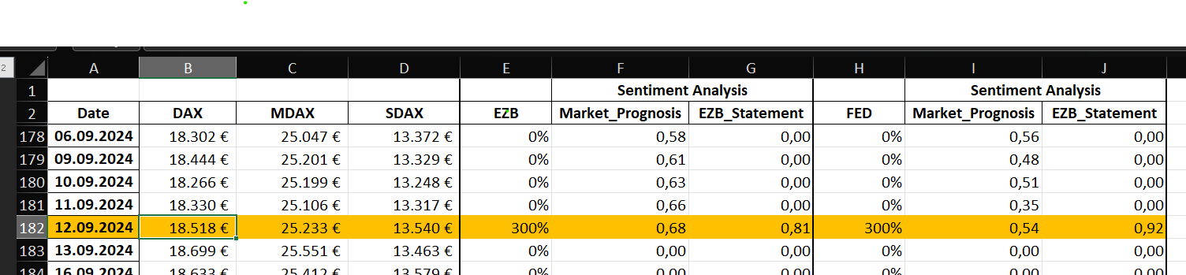
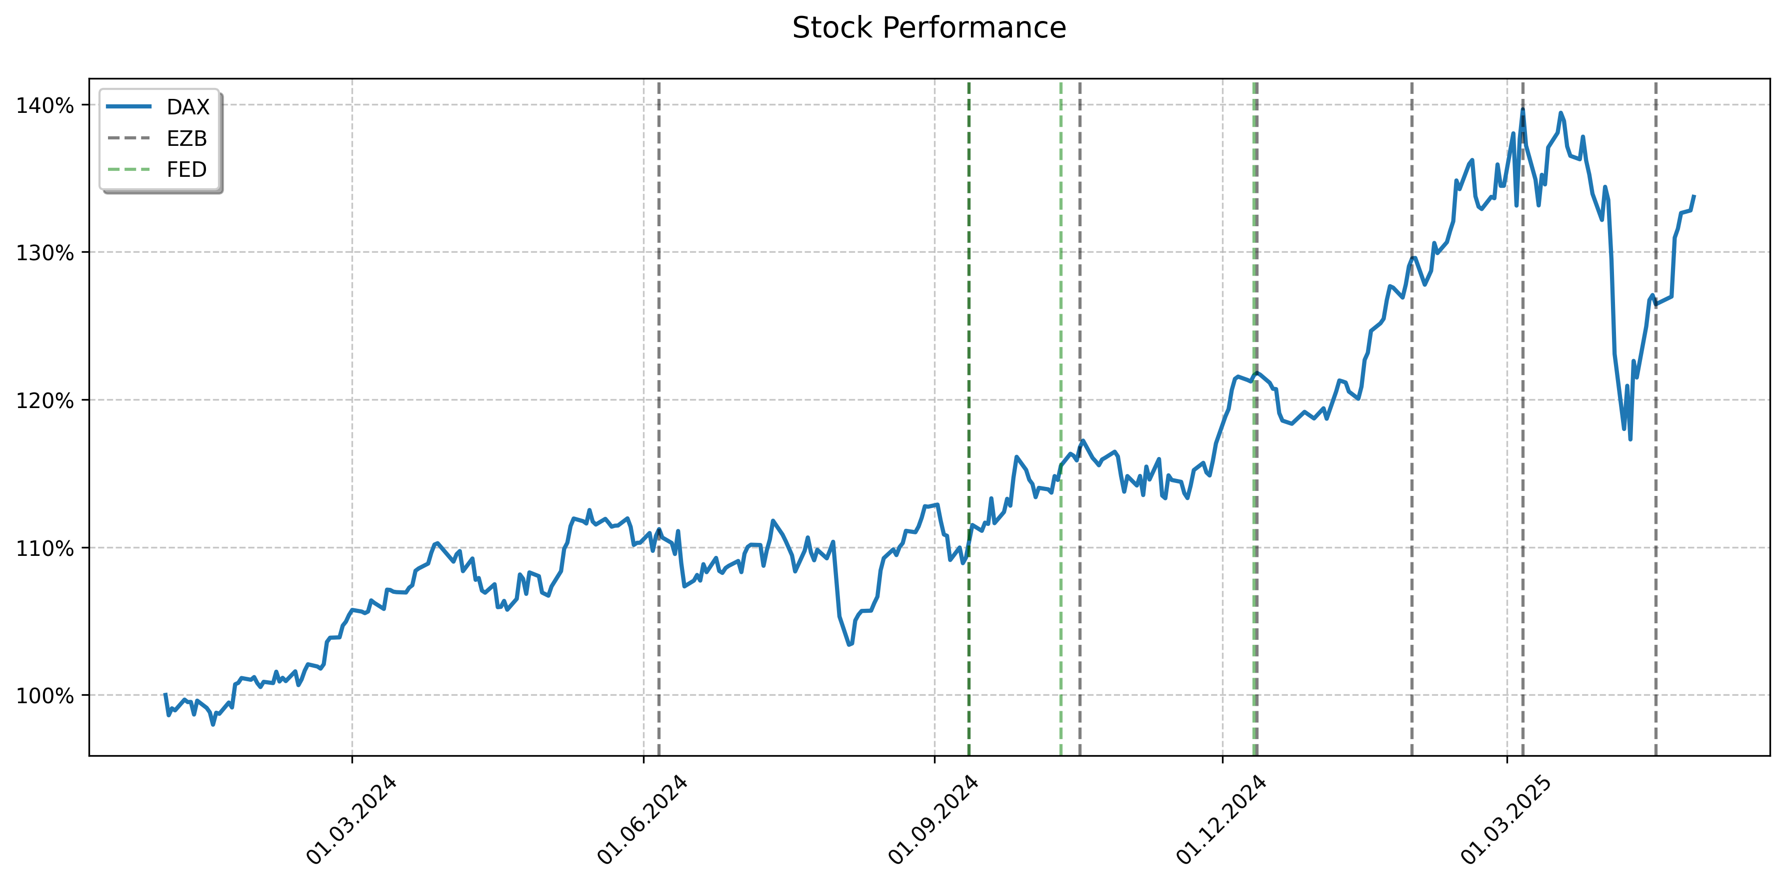
A Visual Example

Slide 15

My Approach
Predict the Change in the Underlying
Interest rate change
Market Anticipation
Sector
Press statement
Notes:
https://www.bing.com/images/search?view=detailV2&ccid=9ddNQXXH&id=F5B2461AE2A3606D88D191DDE84C184EF6C67099&thid=OIP.9ddNQXXHQKCfsDTgTmP-qAHaFm&mediaurl=https%3A%2F%2Fi.imgflip.com%2F836x0n.png&cdnurl=https%3A%2F%2Fth.bing.com%2Fth%2Fid%2FR.f5d74d4175c740a09fb034e04e63fea8%3Frik%3DmXDG9k4YTOjdkQ%26pid%3DImgRaw%26r%3D0&exph=499&expw=659&q=Pepe+Silvia+Meme+transparent&simid=608033813921953136&form=IRPRST&ck=83B80A5F7ABC04C162C9A319FCC2C3D6&selectedindex=0&itb=1&ajaxhist=0&ajaxserp=0&vt=0&sim=11

Slide 16
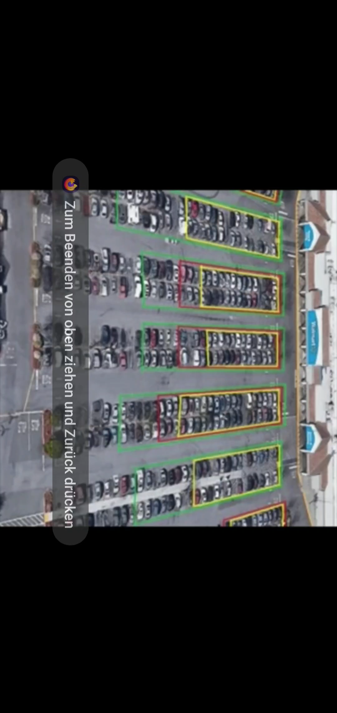
Notes:
Source:https://youtu.be/TQuxVz52w2w?si=7ag-qzwCv776V-9l

Slide 17

My Approach
Predict the Change in the Underlying
Interest rate change
Interest Rate Regime
Press statement
Market Anticipation
Notes:
https://www.bing.com/images/search?view=detailV2&ccid=9ddNQXXH&id=F5B2461AE2A3606D88D191DDE84C184EF6C67099&thid=OIP.9ddNQXXHQKCfsDTgTmP-qAHaFm&mediaurl=https%3A%2F%2Fi.imgflip.com%2F836x0n.png&cdnurl=https%3A%2F%2Fth.bing.com%2Fth%2Fid%2FR.f5d74d4175c740a09fb034e04e63fea8%3Frik%3DmXDG9k4YTOjdkQ%26pid%3DImgRaw%26r%3D0&exph=499&expw=659&q=Pepe+Silvia+Meme+transparent&simid=608033813921953136&form=IRPRST&ck=83B80A5F7ABC04C162C9A319FCC2C3D6&selectedindex=0&itb=1&ajaxhist=0&ajaxserp=0&vt=0&sim=11
https://www.pngwing.com/en/free-png-arnzw/download
https://worldvectorlogo.com/de/logo/openai-wordmark

Slide 18
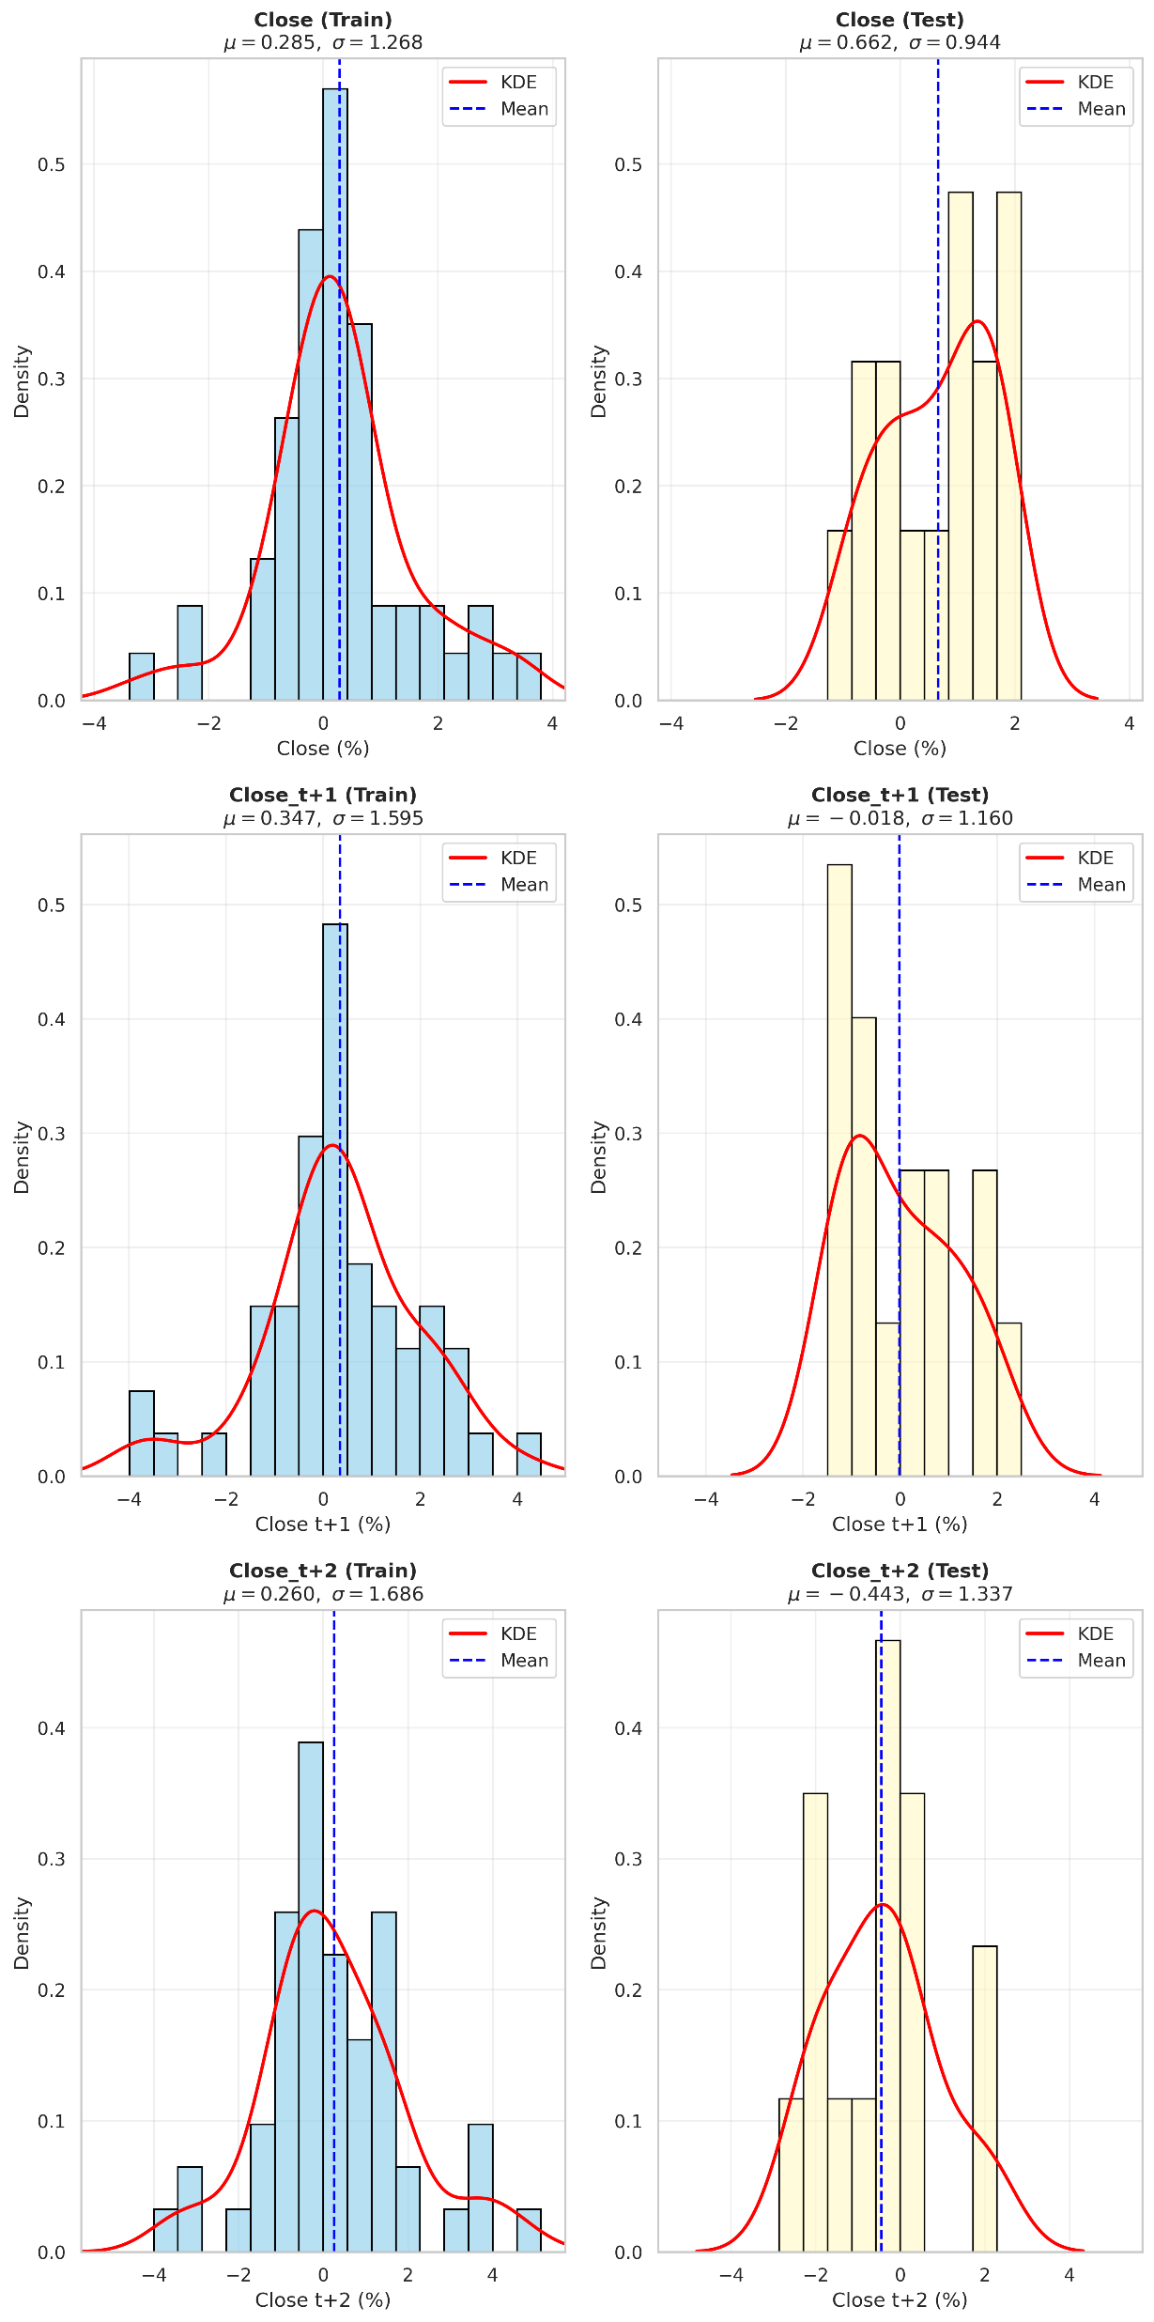
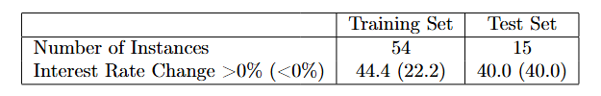
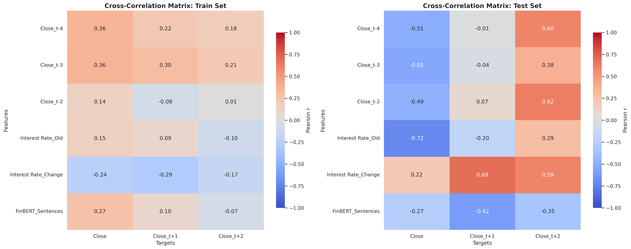
Train/Test set

Slide 19
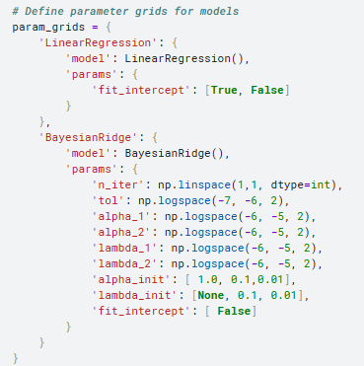
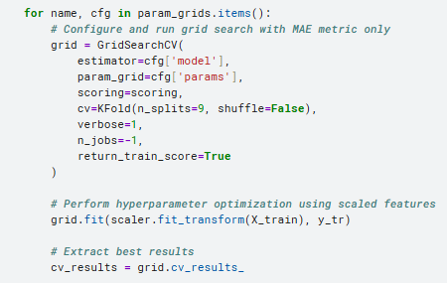
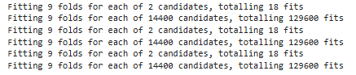
Hyperparamter Configuration

Slide 20
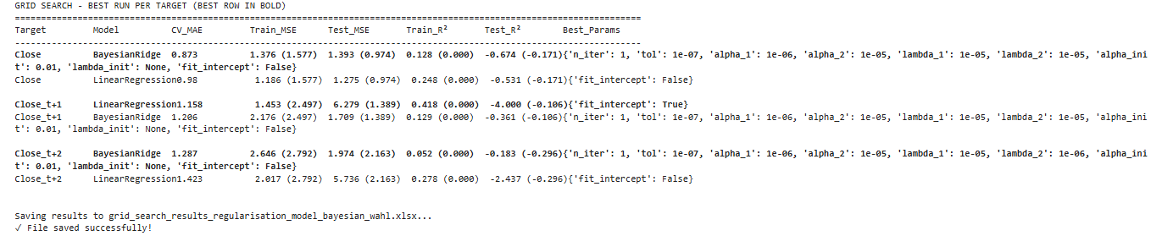
Hyperparameter Results

Slide 21
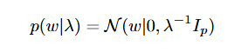
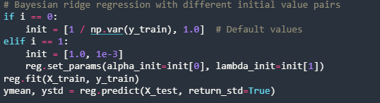
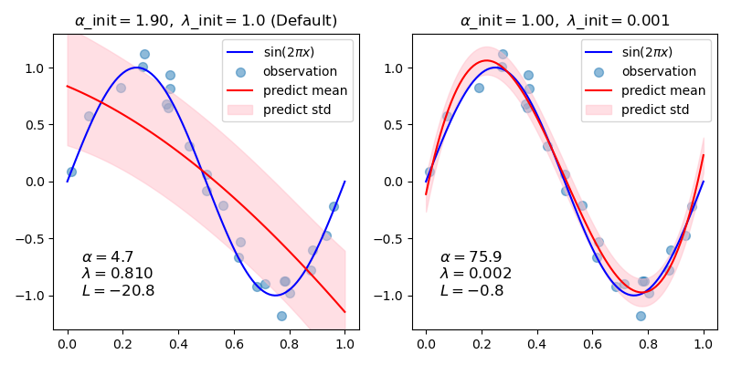
Bayesian Ridge Regression
Notes:
https://scikit-learn.org/stable/auto_examples/linear_model/plot_bayesian_ridge_curvefit.html#sphx-glr-auto-examples-linear-model-plot-bayesian-ridge-curvefit-py

Slide 22
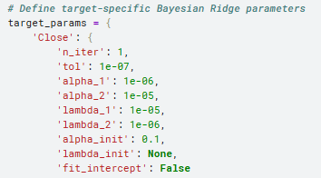
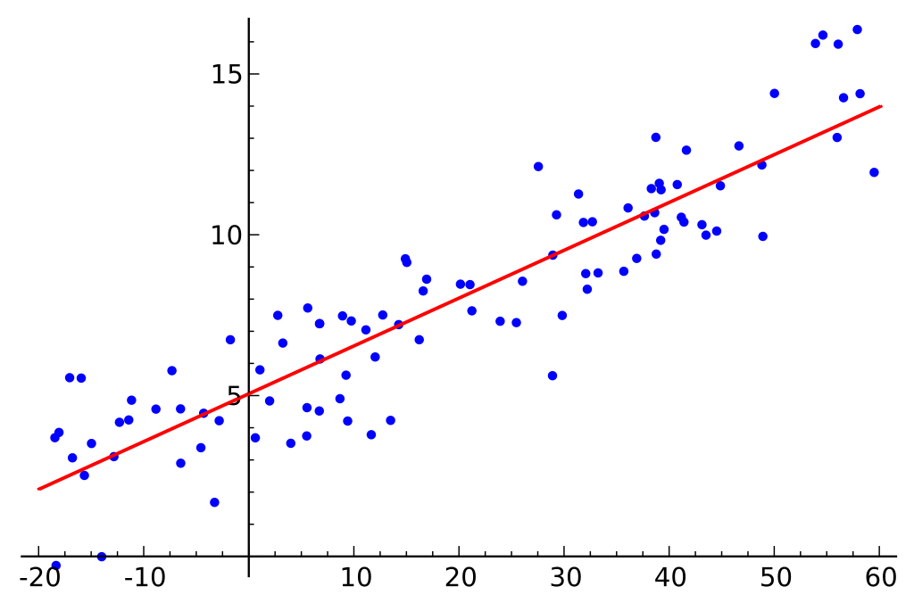
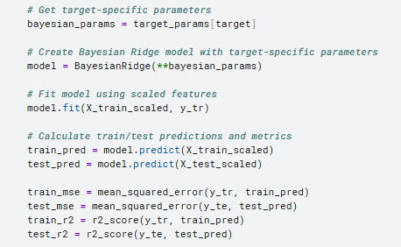
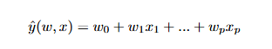
Linear Regression
Notes:
https://en.wikipedia.org/wiki/Linear_regression#/media/File:Linear_regression.svg

Slide 23
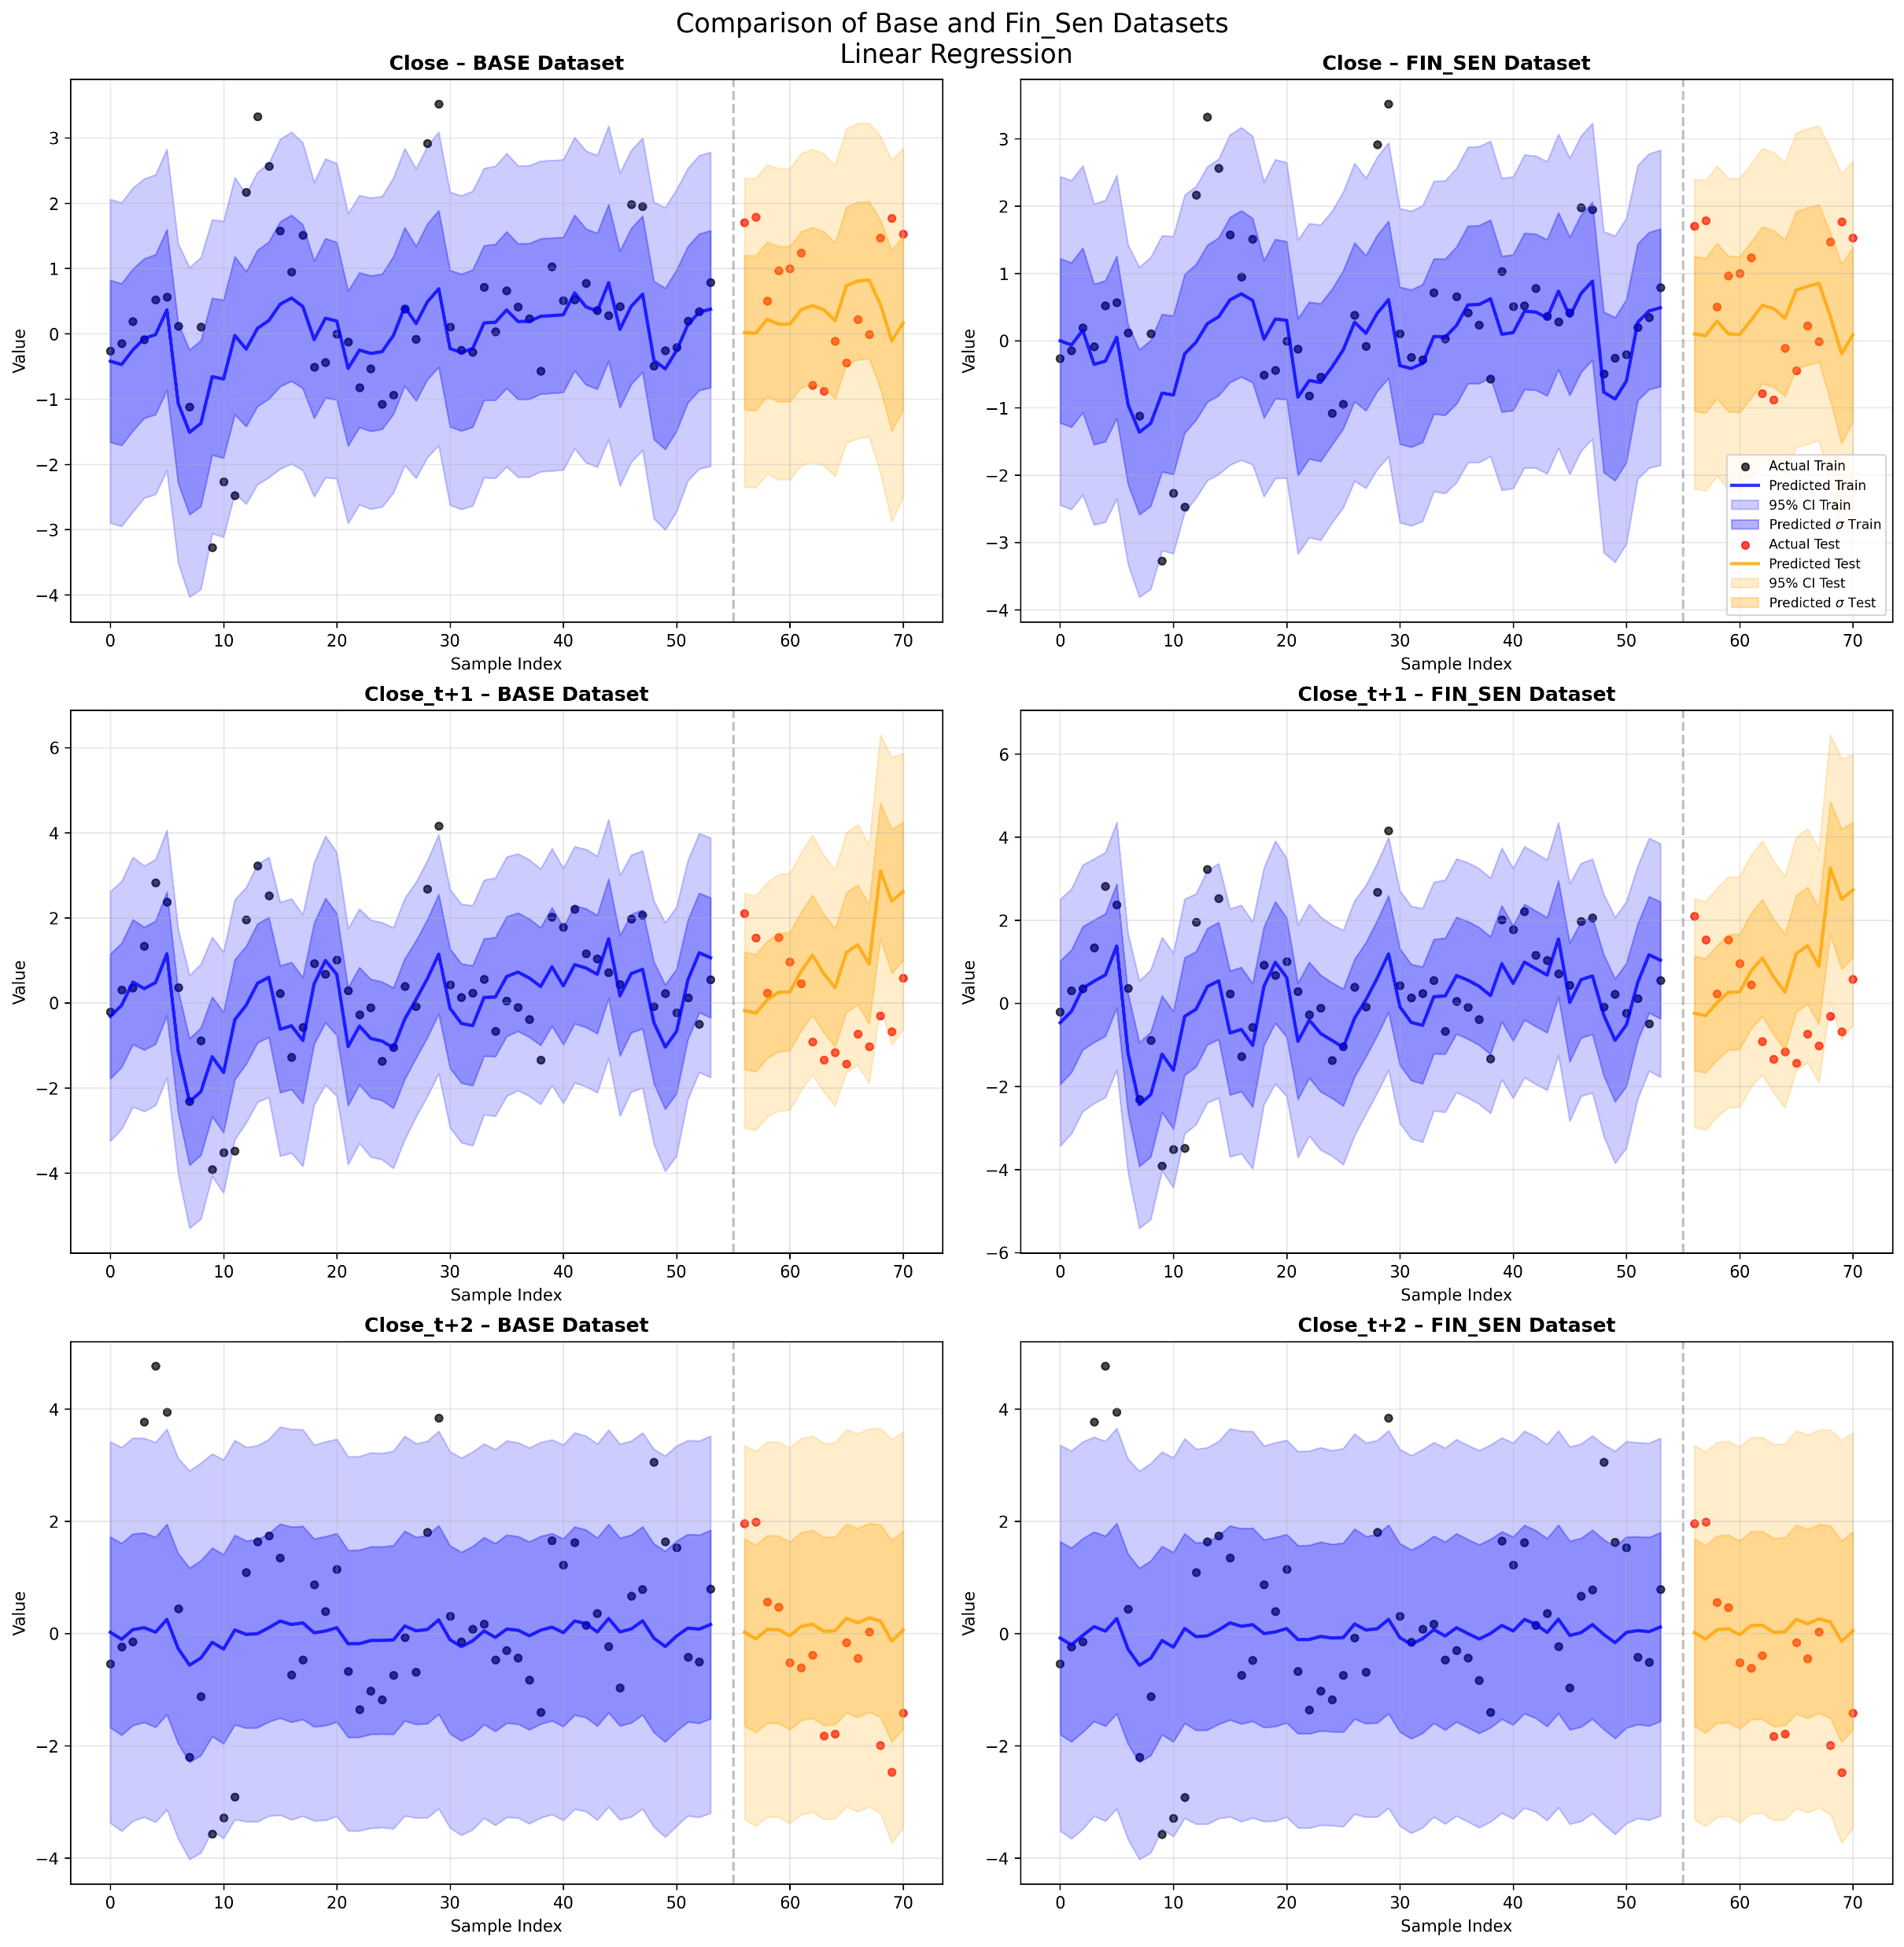
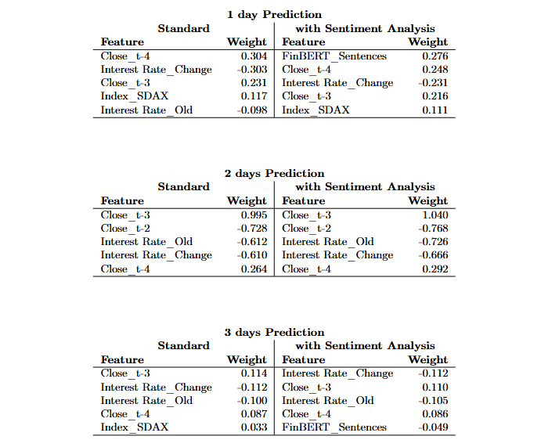

Slide 24
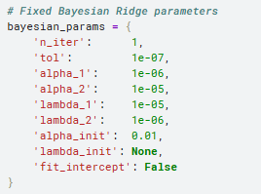
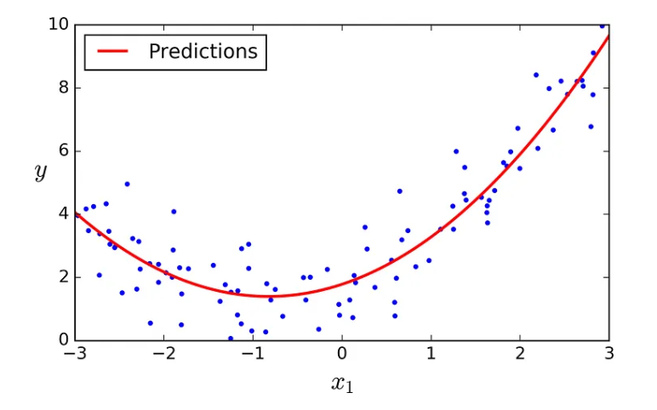
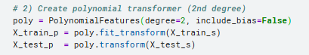
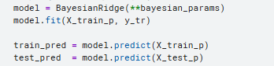
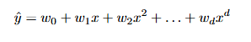
Polynomial Regression
Notes:
https://medium.com/@renadalhendy/build-a-polynomial-regression-model-in-python-using-scikit-learn-1b5fd31beb02

Slide 25
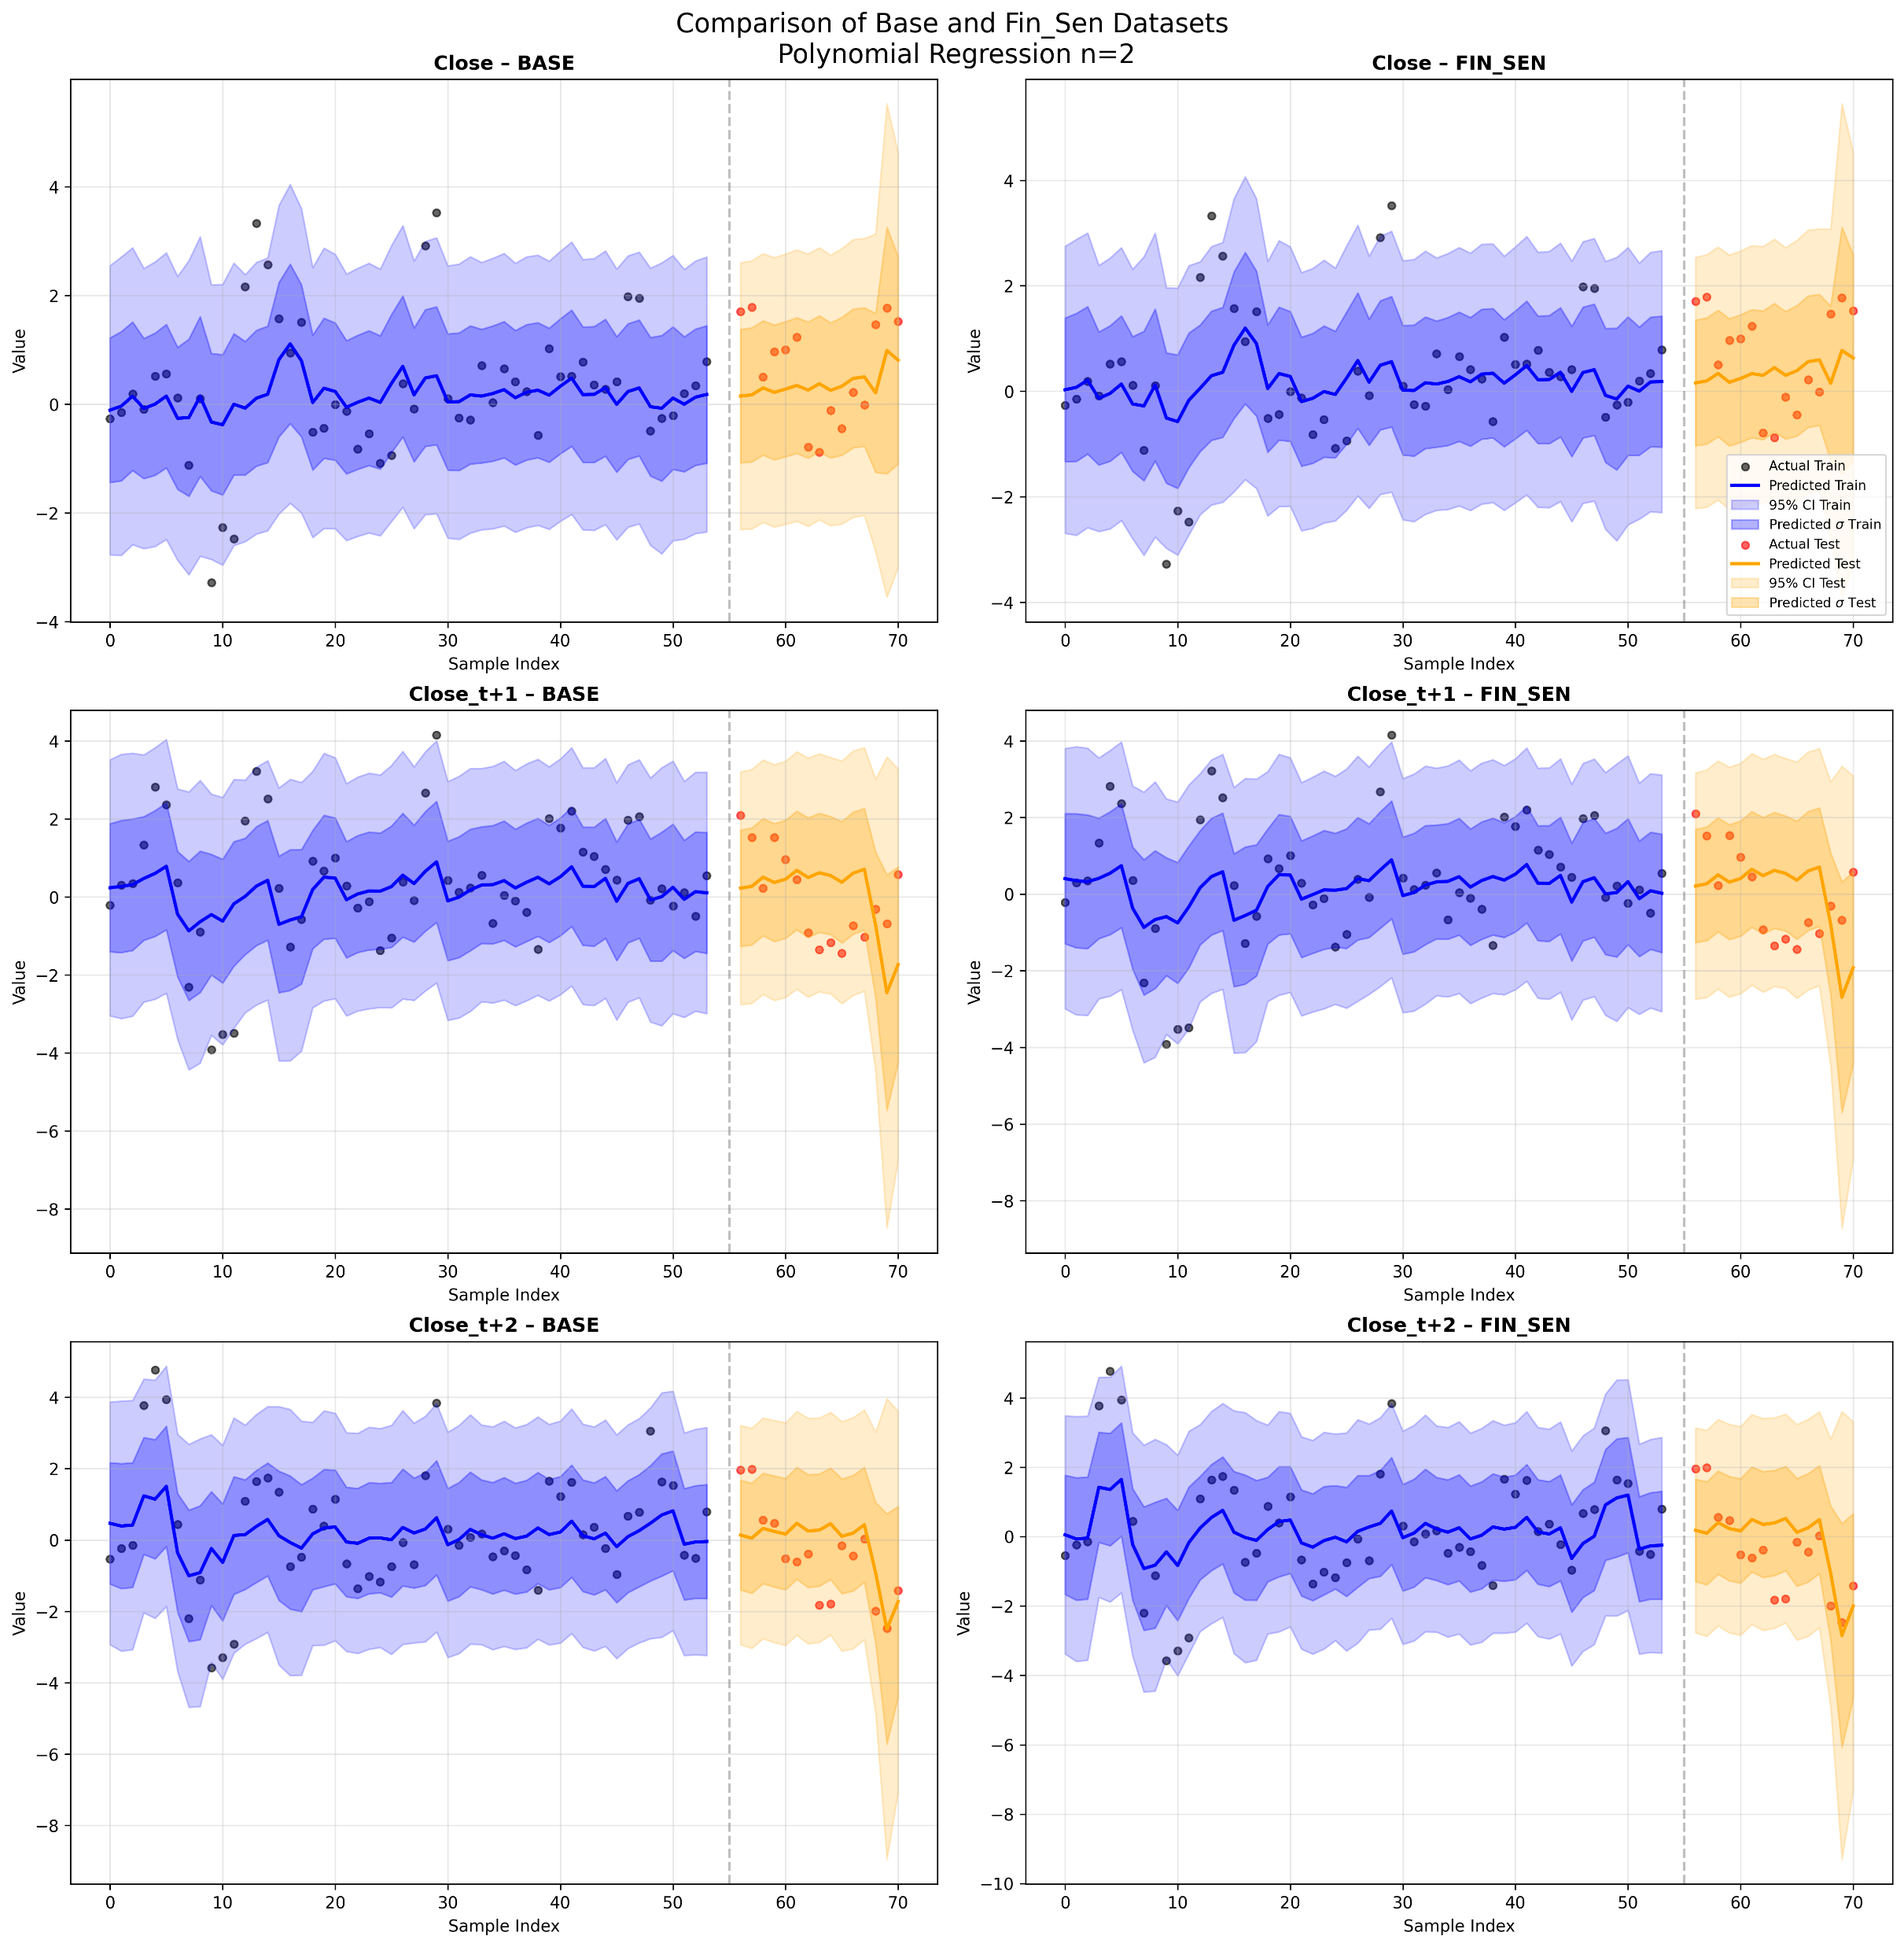
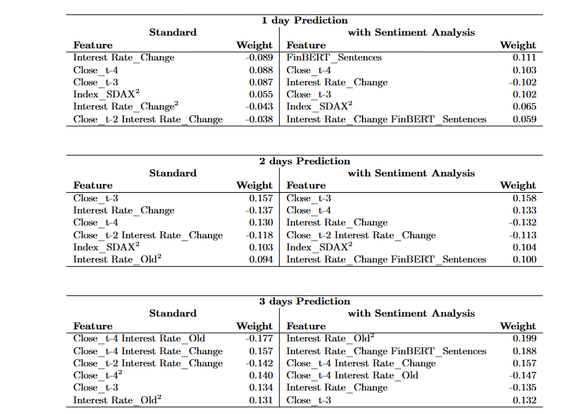

Slide 26
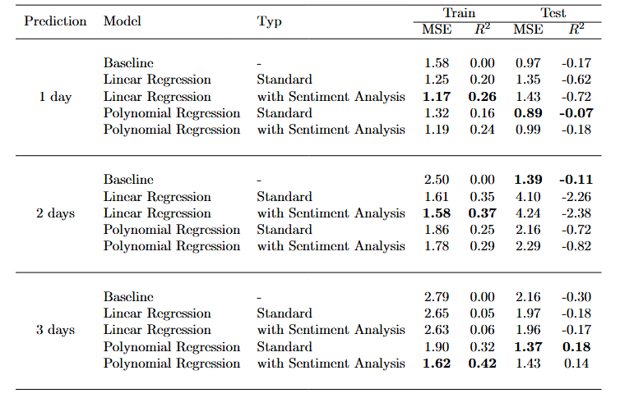
Evaluation

Slide 27
Project Outline
Sentiment Analysis
Logistic Regression
(Multiple) Linear Regression
LSTM-Modell

Slide 28
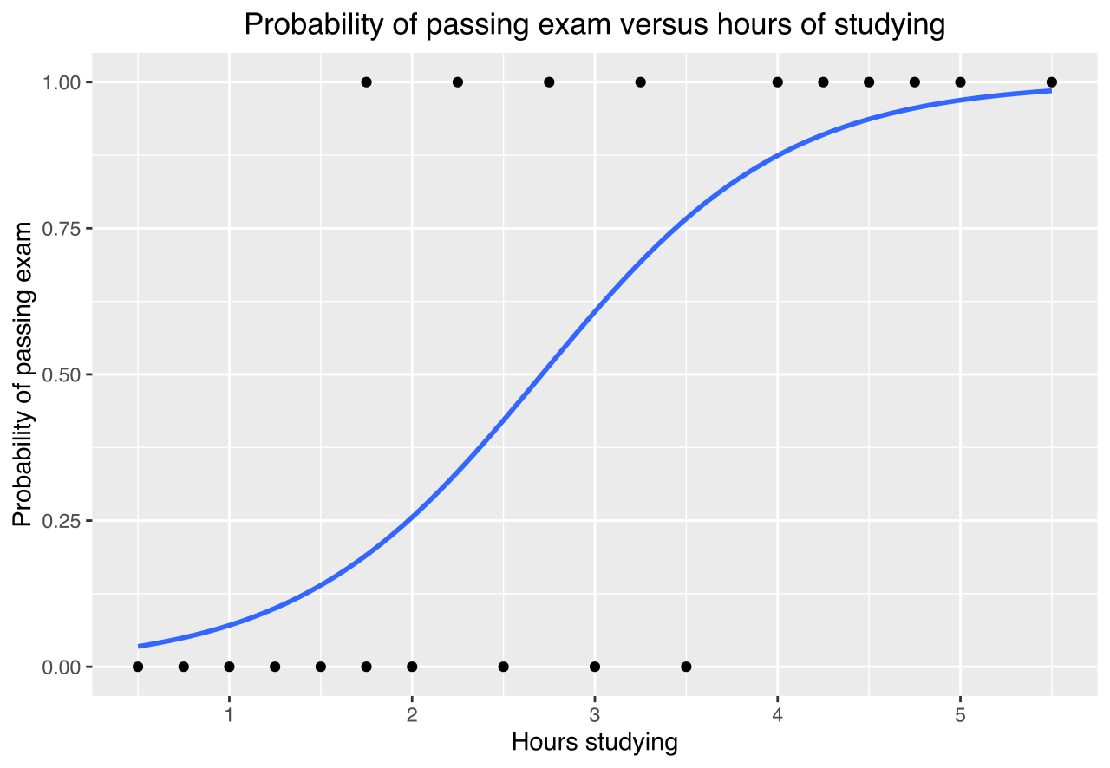
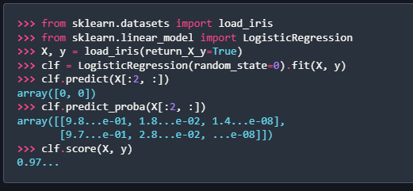
Logistic Regression
Notes:
https://en.wikipedia.org/wiki/Logistic_regression#/media/File:Exam_pass_logistic_curve.svg/2 https://scikit-learn.org/stable/modules/generated/sklearn.linear_model.LogisticRegression.html

Slide 30
Project Evaluation
Key Question = How Well does my Model Perform?
Backtesting
Comparison to Baseline
Regression Evaluation:
Accuracy (Logistic)
Adjusted R²(Linear)

Slide 31
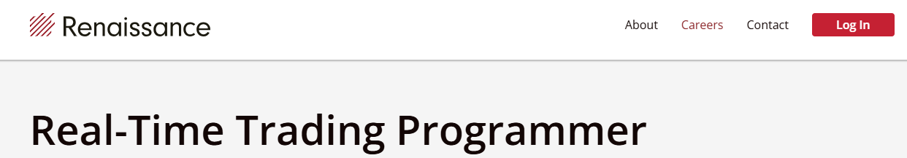
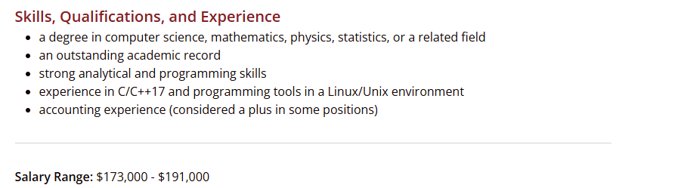
Notes:
https://www.rentec.com/Careers.action?jobs=true&selectedPosition=realtimeTradingProgrammer

Slide 32
References
https://papers.ssrn.com/sol3/papers.cfm?abstract_id=2941281
https://www.kaggle.com/learn
https://www.ecb.europa.eu/home/html/index.en.html

